Slide 1

BDM Project– SPORTS ANALYTICS
Anup Shaw (G23AI2015)
Mudit Kumar (G23AI2037)
Anas Khan (G23AI2119)
Supervised By:
Dr. Dip Shankar Banerjee Sir

Slide 2
Agenda
Introduction
Data Overview & Preprocessing
Project Management
ETL Process & Architecture
Challenges & Limitations
Statistical Findings
Sports Analytics App Overview
Dashboard Overview
Conclusion

Slide 3
Introduction
Sports analytics is the systematic analysis of sports data to gain insights, improve performance, and drive decision-making in athletic environments. By combining statistics, technology, and data science, sports analytics has revolutionized how teams, coaches, and athletes approach training, strategy, and competition.
It integrates advanced tools such as machine learning, predictive modeling, and big data to drive better decisions both on and off the field. This powerful combination of data and technology is transforming not only sports performance but also the business of sports, ushering in a new era of precision and efficiency.
The adoption of sports analytics gained significant attention after the success of the “Moneyball” approach, popularized by the Oakland Athletics baseball team.
Sports analytics has become integral to virtually every professional and amateur sport, including basketball, soccer, tennis, cricket, and American football.

Slide 4
Data Overview & Preprocessing
Match Data:
Teams: Details about the home and away teams participating in each match.
Scores: Final scores for each match, providing insight into performance.
Dates and Locations: Information about when and where matches were played, useful for analyzing temporal and geographic trends.
Player Data:
Goals and Assists: Metrics highlighting player contributions to match outcomes.
Minutes Played: A measure of player engagement and stamina over the season.
Cards: A measure to showcase about plays receiving yellow or red cards

Slide 5
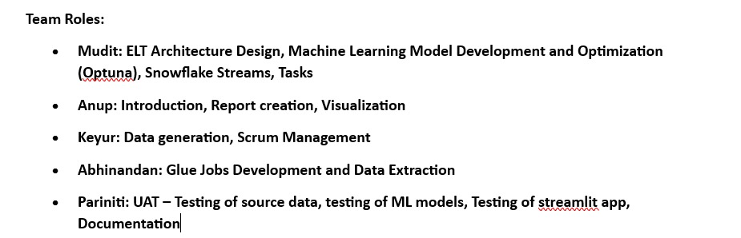
Project Management

Slide 6
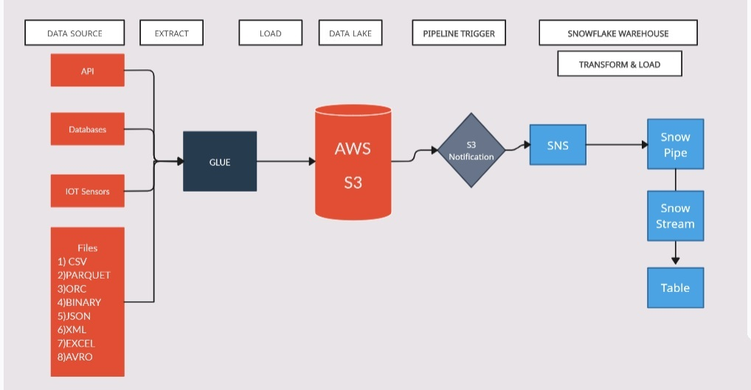
ETL Process & Architecture
Data Analytics

Slide 7
Challenges & Limitations
Data Gaps and Quality Issues
The dataset contained missing or incomplete records, particularly in older matches where statistics such as attendance and weather conditions were unavailable. Inconsistencies in player naming conventions and team abbreviations required extensive preprocessing and cleaning to ensure consistency across the analysis.
Limitations of Models and Predictions
While predictive models demonstrated good accuracy, their performance can be limited by the quality of input data. Factors such as tactical adjustments during matches, locations, and team dynamics are not fully captured in structured datasets. XgBoost, although powerful, are computationally expensive and require significant data to avoid overfitting.

Slide 8
Statistical Technique
Features used for prediction –
Weather, City , Team1, Team2 , Attendance
Classification Model–
Used Naive Bayes Model
Logistic regression
Random Forest
XgBoost
LightGBM
Best Model as per Prediction –
XgBoost

Slide 9
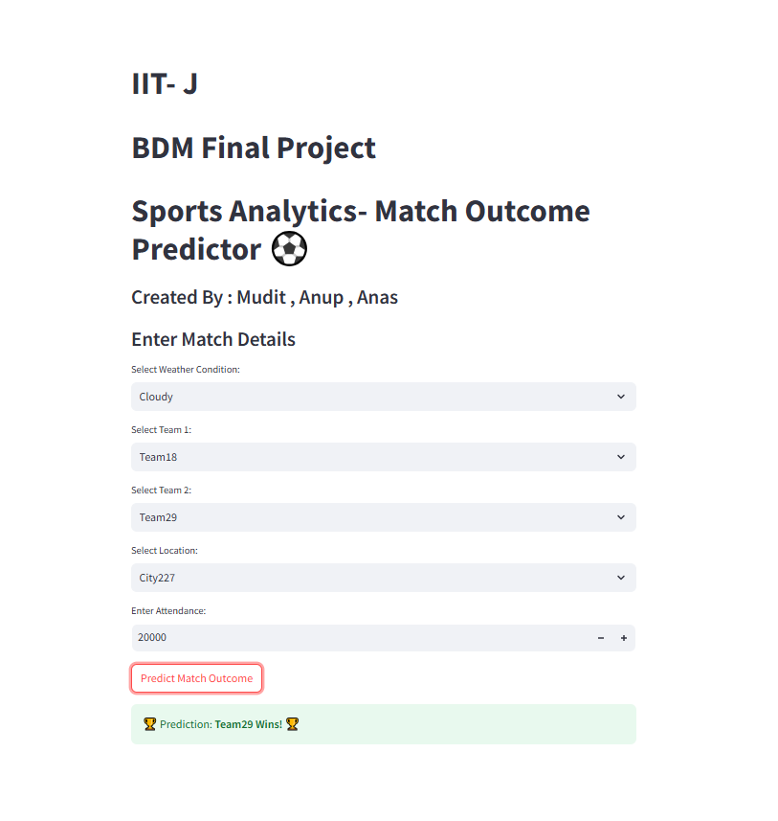
Sports Analytics App Overview

Slide 10
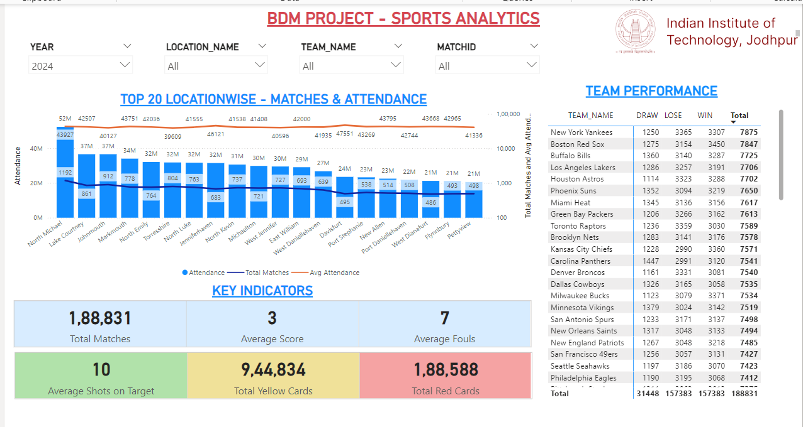
Sports Analytics Dashboard Overview

Slide 11
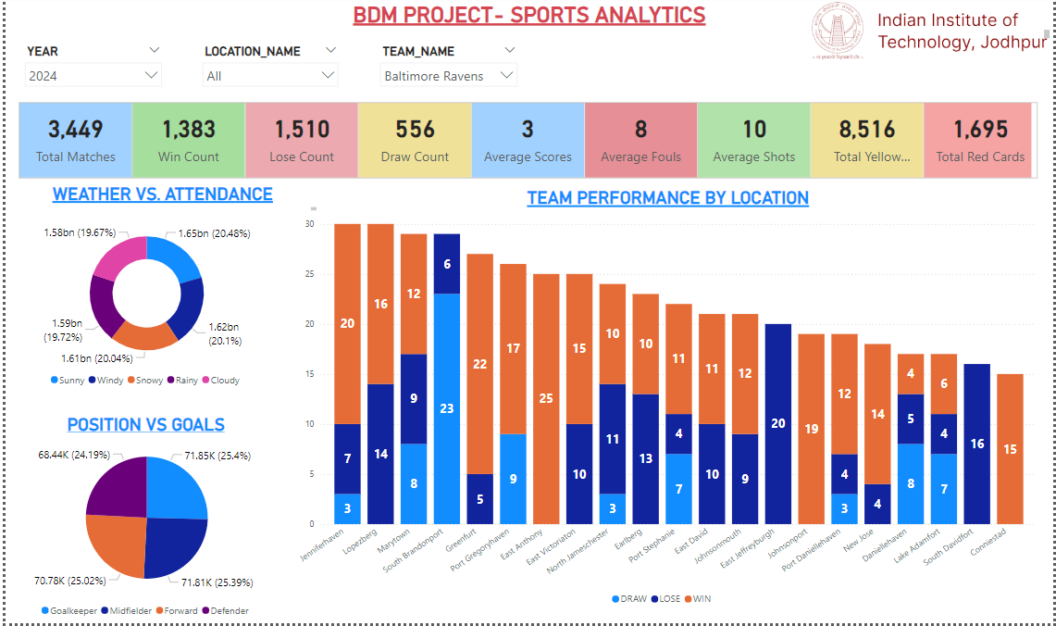
Sports Analytics Dashboard Overview… Contd

Slide 12
Conclusion:
Summary of Insights for Teams, and Analysts
The analysis highlighted key relationships between possession, goals, and match outcomes.
Attendance and weather also emerged as significant external factors influencing team performance.
Player-level analysis identified high-impact contributors and highlighted future performance trends.
Recommendations for Tactical and Recruitment Decisions
Focus on increasing shot conversion rates rather than possession alone to improve match outcomes.
Monitor weather conditions and adapt strategies to maintain performance consistency.
Use predictive analytics to identify players at risk of injury and manage their workload to avoid burnout.
Prioritize recruiting players with strong goal efficiency and assist metrics to enhance team performance.

Slide 13
THANK YOU

